Slide 1

Binarized Neural Architecture Search
Hanlin Chen, Li’an Zhuo, Baochang Zhang, Xiawu Zheng, Jianzhuang Liu, David Doermann, Rongrong Ji
Beihang University
Shenzhen Institutes of Advanced Technology,
University of Chinese Academy of Sciences
AAAI, 2020
Reporter: Tang Qidong, 2020.12/15
Notes:
The paper I present today is “Binarized Neural Architecture Search”
It was published on AAAI 2020. 北航的文章

Slide 2
Outline
Preliminary of DARTS/PC-DARTS
Motivation and Contribution
Methods
Experiments and Thinking

Slide 3
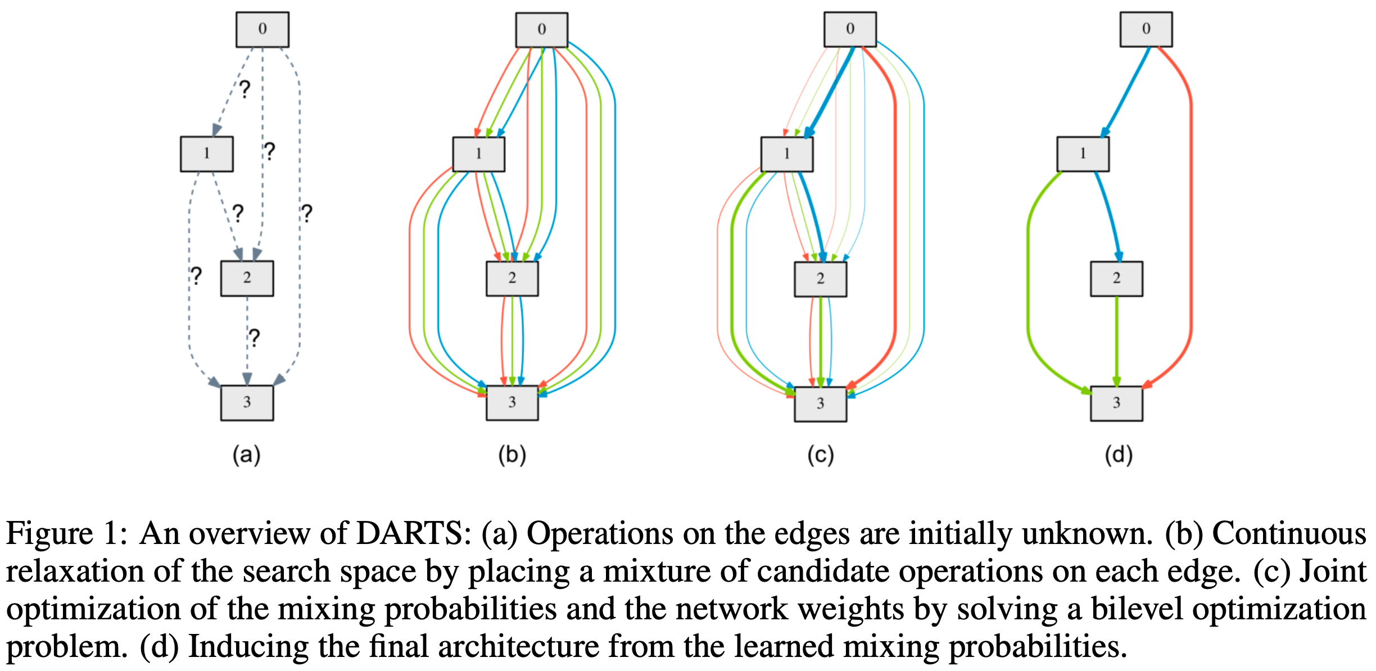
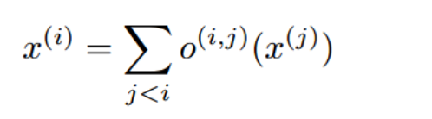
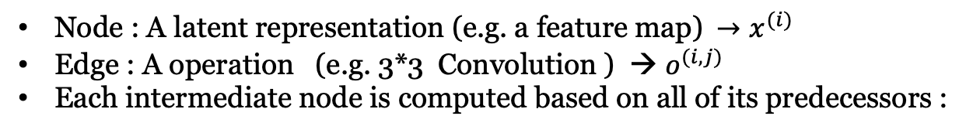
Overview of DARTS
Node : A latent representation (e.g. a feature map) ${ →x}^{(i)}$
Edge : A operation (e.g. 3*3 Convolution ) → $o^{(i,j)}$
Each intermediate node is computed based on all of its predecessors :
Notes:
1.DARTS 的搜索空间是一个个cell组成的。Cell里的每个节点代表一个特征表示（feature map），每条边代表一operation ，如图a
2.DARTS 每条边上，可以有多种operations。如图b，每两个节点之间3条边代表3种operations，每个node的feature map是这三个operations的输出之和
3.图C表示对两个节点之间的边使用 softmax 松弛化，softmax 的输出代表每个operation的权重， 结果是这两个节点之间eperation的加权和。
4.最终选择两个节点间权值最大的那个operation

Slide 4
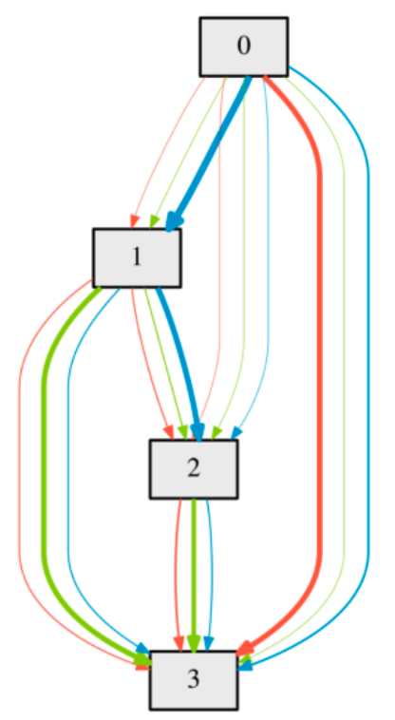
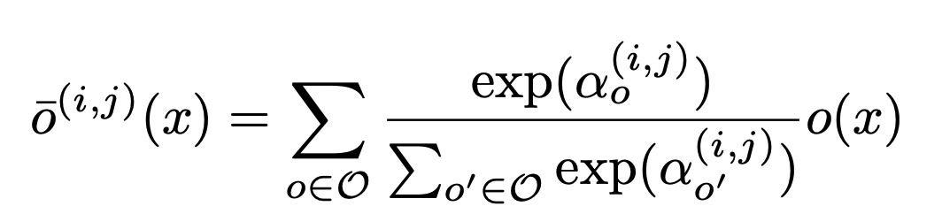
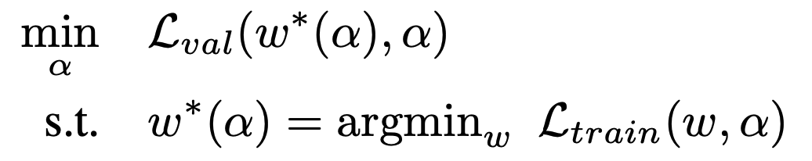
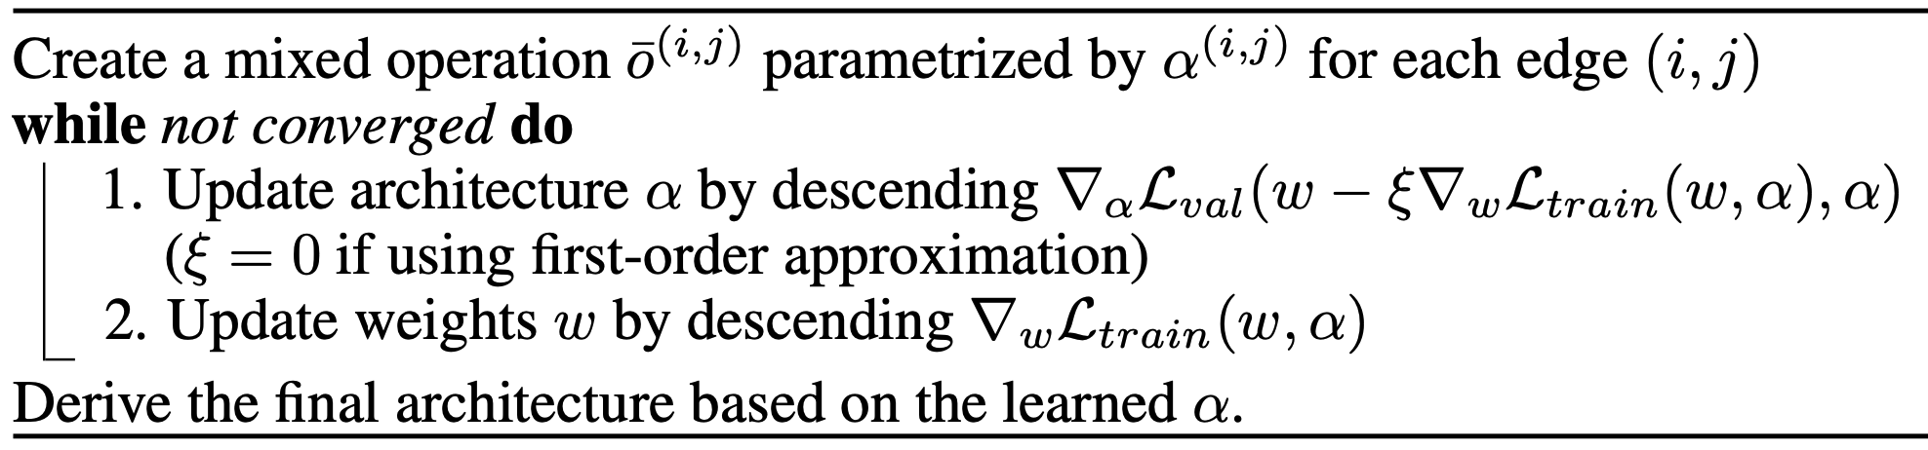
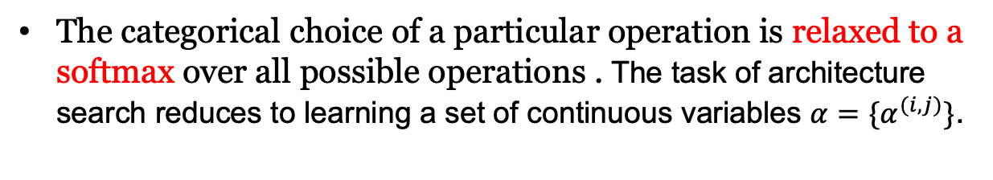
Continuous Relaxation and Optimization
The categorical choice of a particular operation is relaxed to a softmax over all possible operations . The task of architecture search reduces to learning a set of continuous variables $α=\{α^{(i,j)}\}$.
\
Bilevel optimization problem :
Notes:
这一页表示如何对darts的多个operations进行松弛化操作。即将softmax的输出作为选择某种operation的概率。
我们将这个松弛化的变量记作alpha，将每个算子的权重记作w，那么DARTs的优化目标就是同时优化alpha和w。
这是一个双层的优化问题，优化目标如上式所示。最终目标是在validation数据集上优化alpha，对应的weight是该alpha对应的最优的weight。
所以这个weight是一个内层的优化变量，在train数据集上找到最优的weight。
这样alpha和w迭代优化。但是如果内层循环每次都要找到最优的w，会非常费时，所以实际的方法是内存循环只训练一个或几个step，

Slide 5
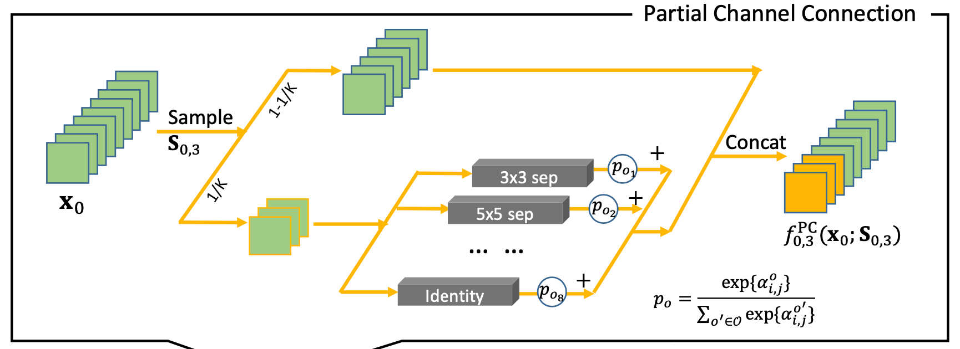
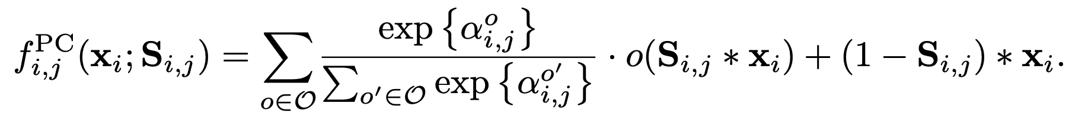
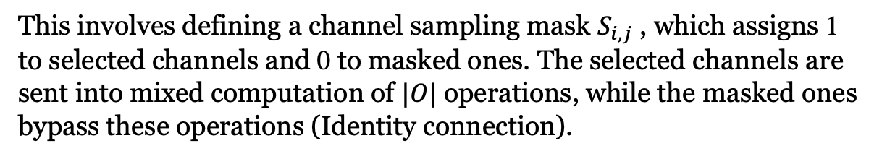
Partial Channel Connections
This involves defining a channel sampling mask $S_{i,j}$ , which assigns 1 to selected channels and 0 to masked ones. The selected channels are sent into mixed computation of $|O|$ operations, while the masked ones bypass these operations (Identity connection).
Notes:
DARTS 的一个明显的缺点在于其内存开销大。如果搜索空间的算子数量是C，那么训练一个超网络所需要的内存消耗大约是一个正常网络的C倍。
为了解决这个问题，PC-darts 提出一种通道采样策略，只随机采样部分通道输入待选操作。以上图为例，x0表示一个feature map，被选择的通道，即下半部分的1/K，如正常搜索算法一样被输入C个eperation，而未被选择的通道直接与通过operation操作的部分的输出并联作为下一个节点的输入。
即被选择的部分操作如darts正常前向传播，未被选择的部分操作通过恒等连接直接映射。

Slide 6
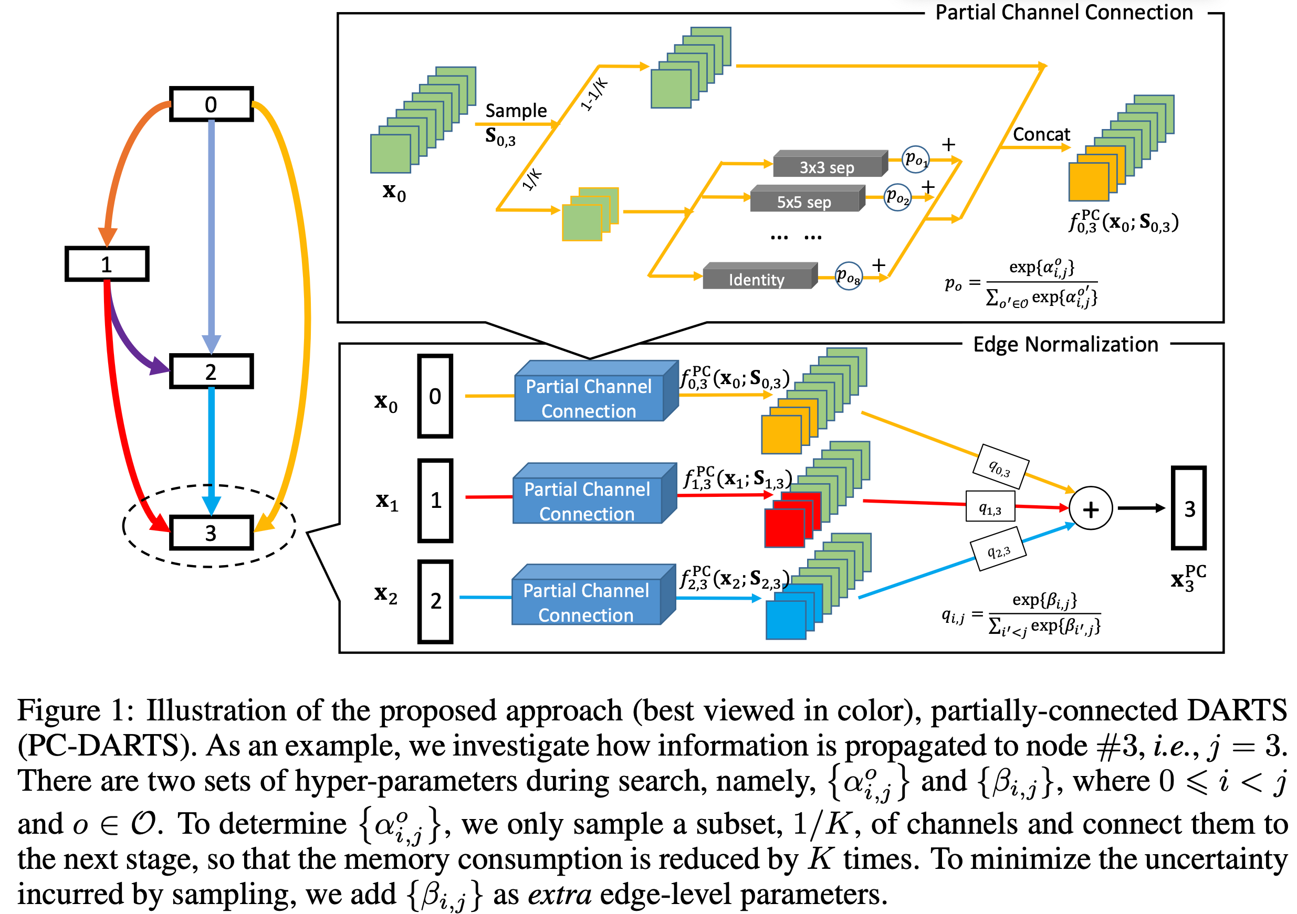
Overview of PC-DARTS
Notes:
这张图是PC-darts的示意图。上图表示对于任意两个节点之间的操作，都是痛殴 channel sampling来做的。
下图表示对于节点3，总过有0，1，2三个输入。对于每个输入，都对应了一组operation。那么每个输入对应的那一组边，都进行随机的channel sampling。
部分通道连接使得每次结构参数优化时，采样的是不同的通道。如果依然通过同样的方式来确定最优边，就可能增大超网络和子网络直接的误差，带来不稳定的搜索结果。为了解决这个问题，作者提出边正则化方法，即引入额外一组边参数β_{i,j} 来显式地加权边：

Slide 7
Motivation and Contribution
Motivation
The searched network (e.g. by DARTS) suffers from an inefficient inference process due to the complicated architectures generated by multiple stacked full-precision convolution operations. The adaptation of the searched network to an embedded device is still computationally expensive and inefficient.
Contribution
A new search algorithm which solves the BNNs optimization and architecture search in a unified framework.
The search space is greatly reduced through a performance-based strategy used to abandon operations with less potential, which improves the search efficiency by 40% .
Notes:
BNAS，即binary nas提出的motivation，由nas搜索出来的architecture都是适用于full-precision的，所以运算的效率等还是不高，不能很好的适用于边缘设备、嵌入式设备等
本文的贡献：1.一种新的搜索算法，可在统一框架中解决BNN优化和架构搜索。 2.通过基于性能的策略逐步舍弃一些operation，可以大大减少搜索空间，从而将搜索效率提高40％。

Slide 8
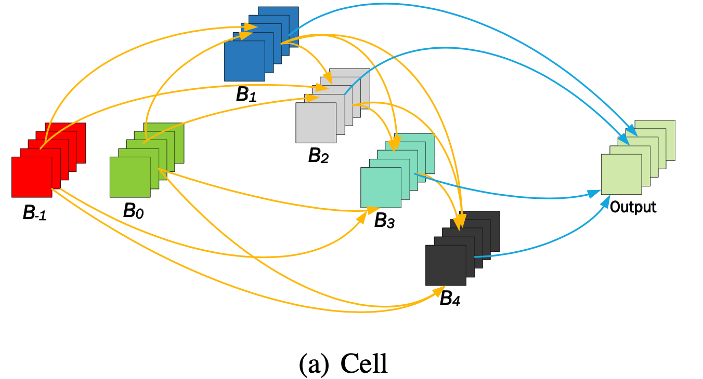
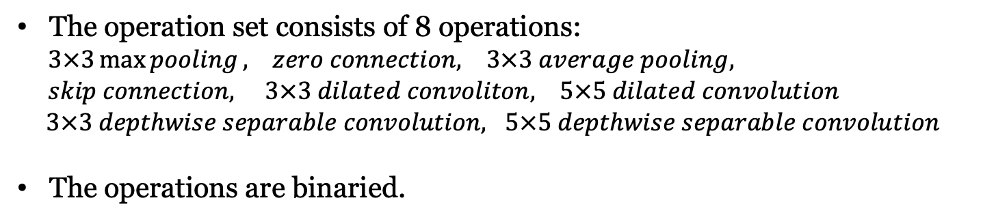
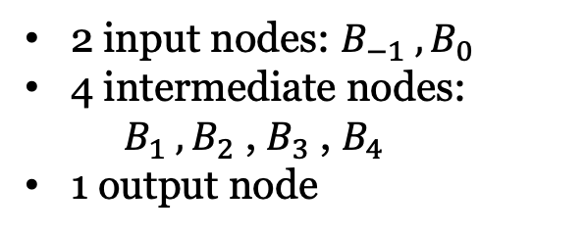
Methods -- Search Space
2 input nodes: $B_{−1} ,B_{0}$
4 intermediate nodes:
${ B}_{1} ,B_{2}$ , $B_{3}$ , $B_{4}$
1 output node
The operation set consists of 8 operations:
$3×3\max{pooling}, zero connection, 3×3 average pooling,$
$skip connection, 3×3 dilated convoliton, 5×5 dilated convolution$
$3×3 depthwise separable convolution, 5×5 depthwise separable convolution$
The operations are binaried.
Notes:
在这篇BNAS中，沿用了DARTS的基础设置。Cell-based搜索。每个cell内4个节点。B-1,B0输入节点，1234中间节点。这4个节点的feature map拼接起来就成了最终的output。
8种operation
每种operation都被 binaried

Slide 9
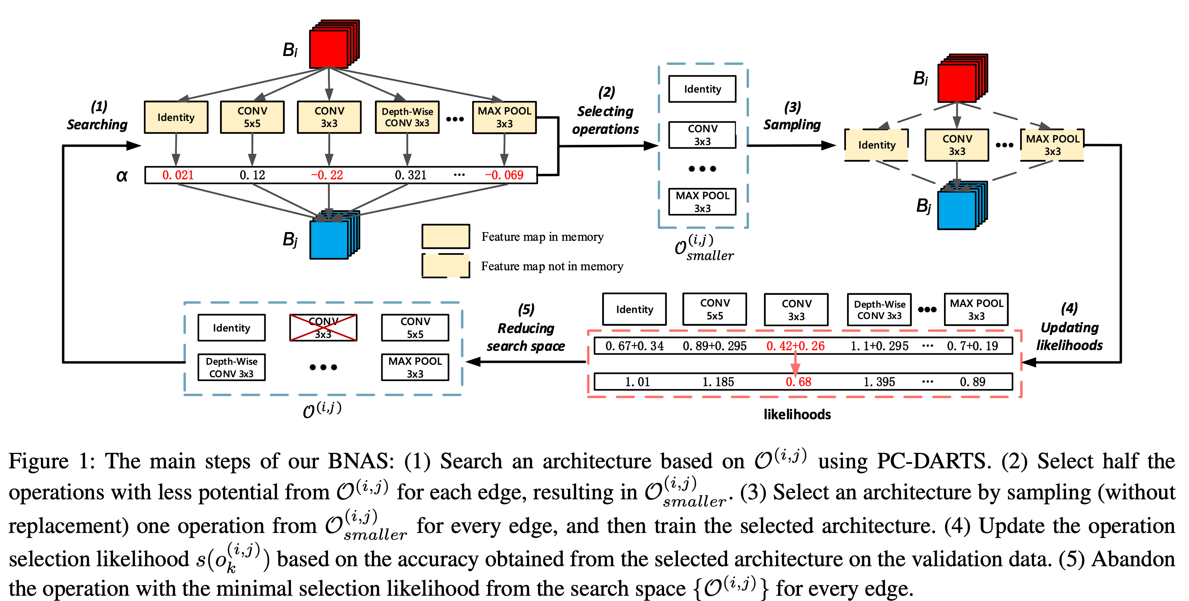
Methods – Overview
Notes:
先使用PC-darts作为warm-up 训练。然后从第二步开始，2.选择一些在当下看起来不太好的operation组成一个smaller集合。3.将这个smaller中的操作挑选出来组成完整的网络。4.这个网络训练的结果，即分类的准确率用来每个衡量operation的好坏，5.最终把表现最差的一个operation从operaion set中抛弃掉。
重复2～5步骤，直到每条边的operation set中只有一个operarion

Slide 10
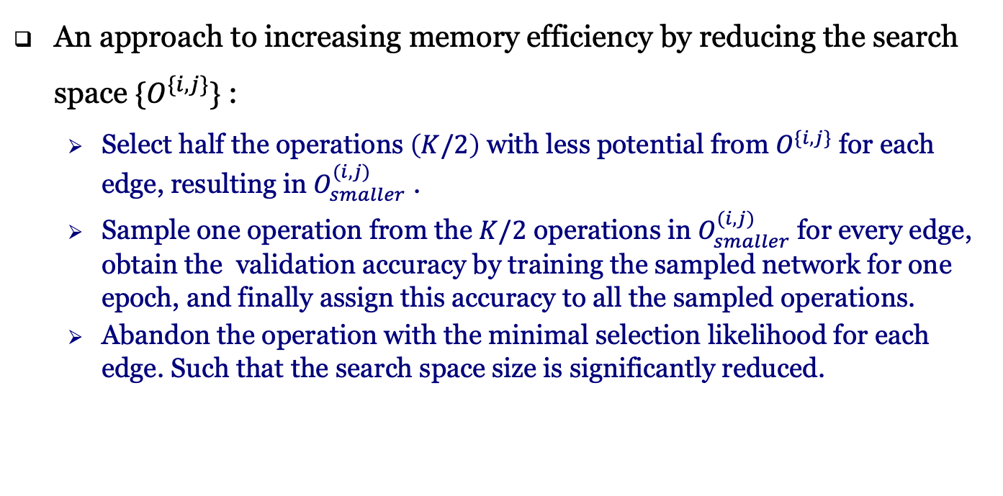
Methods – Sampling and Performance-based Strategy
An approach to increasing memory efficiency by reducing the search space $\{O^{\{i,j\}}\}$ :
Select half the operations $\left(K/2\right)$ with less potential from $O^{\{i,j\}}$ for each edge, resulting in $O_{smaller}^{(i,j)}$ .
Sample one operation from the $K/2$ operations in $O_{smaller}^{(i,j)}$ for every edge, obtain the validation accuracy by training the sampled network for one epoch, and finally assign this accuracy to all the sampled operations.
Abandon the operation with the minimal selection likelihood for each edge. Such that the search space size is significantly reduced.
Why adandon is feasible?
Although in the early stage of training, the validation accuracy ranking of different network architectures is not a reliable indicator of the final architecture quality.
If an architecture performs badly in the beginning of training, there is little hope that it can be part of the final optimal mode
Notes:
在训练过程中，不断的abandon some operations，可以减小搜索空间，提高存储和搜索效率。具体步骤：
1.假设每条边上的operation个数为K，选择potential 最差的K/2个opertion。Potential 的衡量使用alpha的大小
2.使用每条边的 K/2 个operation 来组成网络，训练一个epoch，将对应的accuracy赋给组成这个网络中的所有算子；
3.舍去一个operation
在训练的开始阶段表现好的最后表现不一定好；但是开始表现差的，最后几乎一定不会出现在最优的结构中

Slide 11
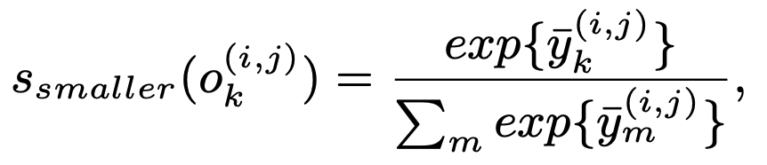
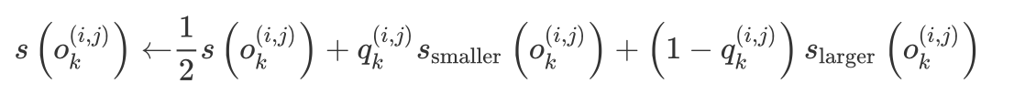
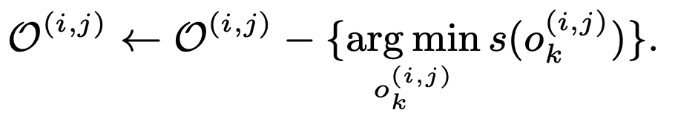
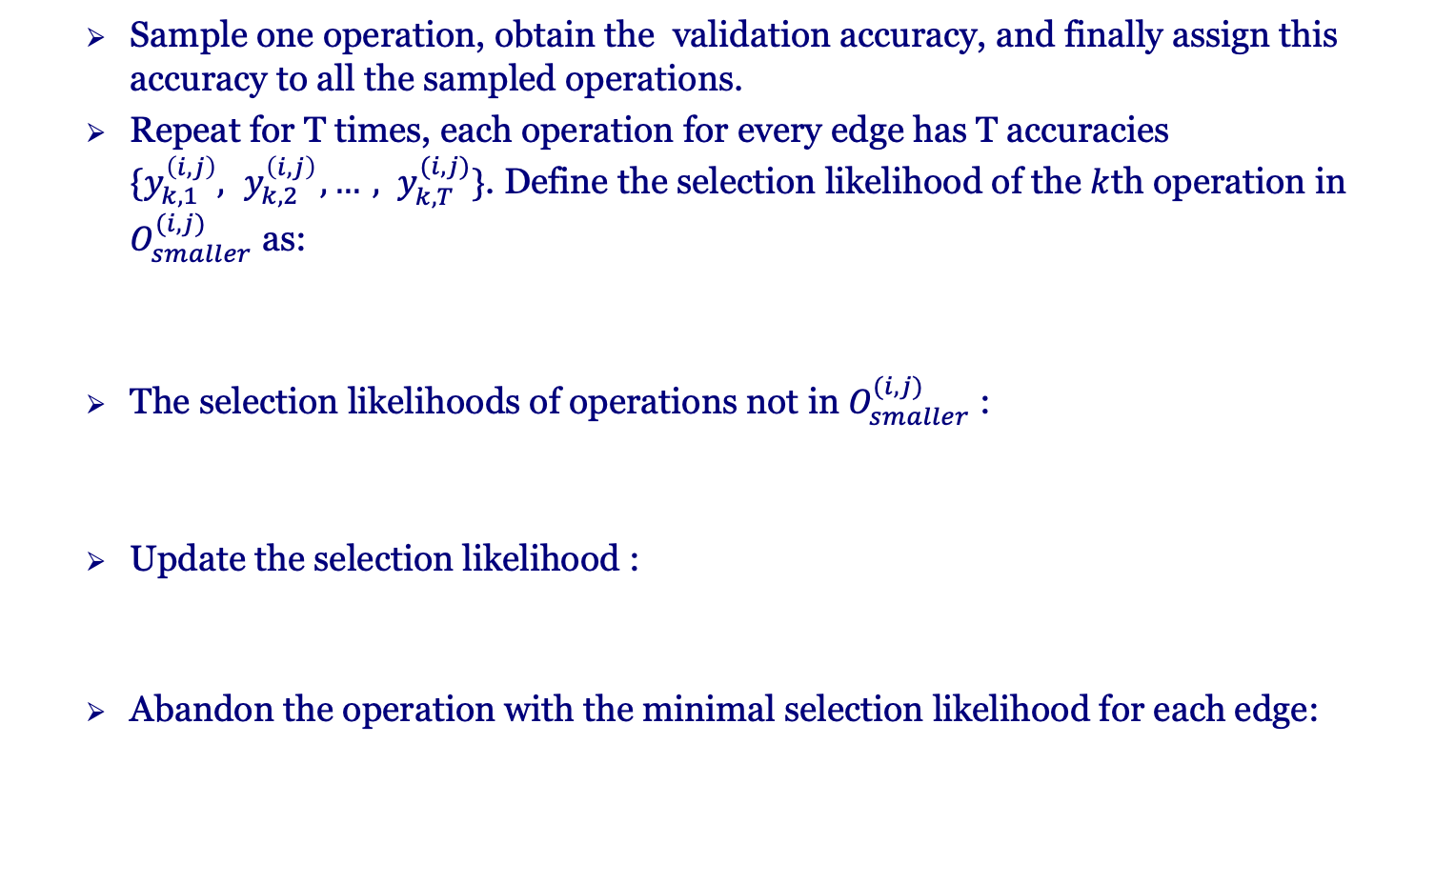
Methods – Sampling and Performance-based Strategy
Sample one operation, obtain the validation accuracy, and finally assign this accuracy to all the sampled operations.
Repeat for T times, each operation for every edge has T accuracies $\{y_{k,1}^{\left(i,j\right)},{ y}_{k,2}^{\left(i,j\right)}, …, y_{k,T}^{(i,j)}\}$. Define the selection likelihood of the $k$th operation in $O_{smaller}^{(i,j)}$ as:
The selection likelihoods of operations not in $O_{smaller}^{(i,j)}$ :
Update the selection likelihood :
Abandon the operation with the minimal selection likelihood for each edge:
Notes:
Small set中k/2个operation，每次不放回的sample一个，最终得到k/2个网络，将这个网络的分类准确率设置为组成这个网络的所有operation的准确率
上述重复T次，每条边上的每个operation都有T个accuracy，均值作为这个operation的accuracy，
selection likelihood，Smaller set，softmax归一化
Larger set，更新公式，使用max 和 mean；
最终用动量的方式更新 selection likelihood。
抛弃minimal selection likelihood。

Slide 12
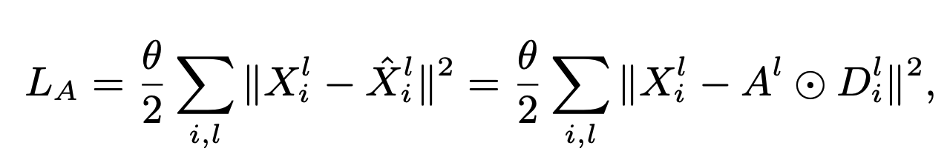
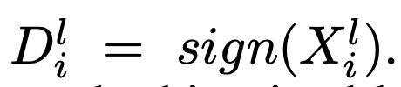
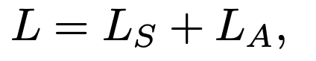
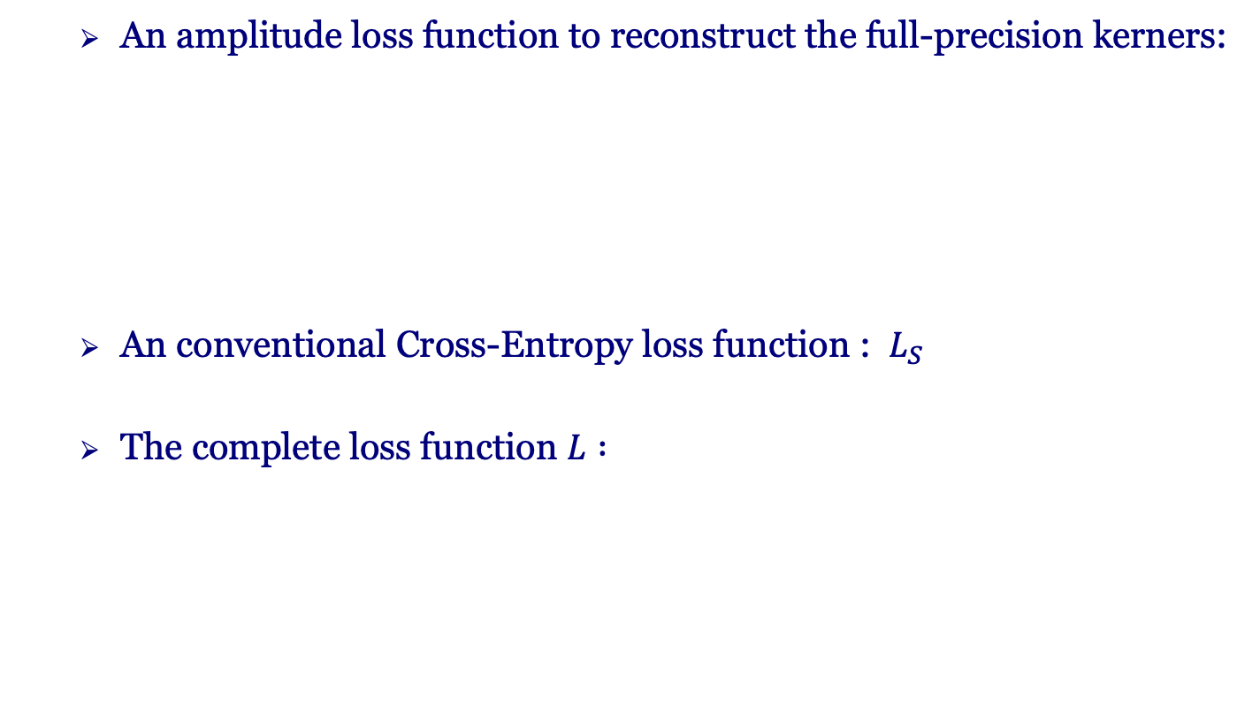
Methods – Optimization for BNAS
An amplitude loss function to reconstruct the full-precision kerners:
An conventional Cross-Entropy loss function : $L_{S}$
The complete loss function $L :$
Notes:
Loss；
LA：激励二值化和full-precision的差距越小越好
LS：分类cross-entropy loss

Slide 13
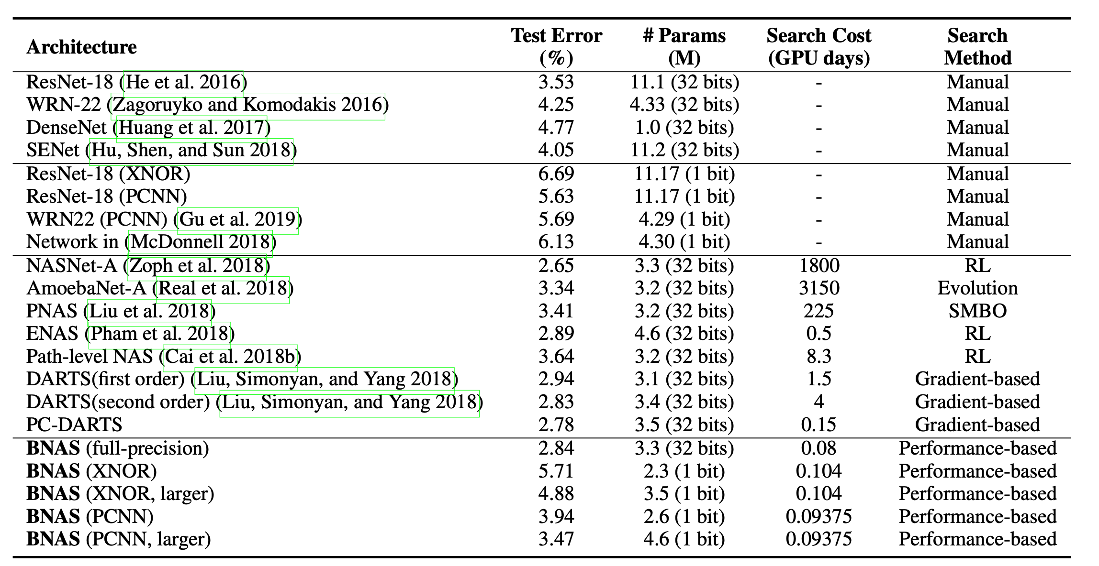
Experiment – Results on CIFAR-10
Comparable to full-precision networks with more compressed models;
Test error significantly smaller than human designed binaried networks;
Faster than previous NAS
Notes:
第一栏是人工设计的float32的网络；第二栏是人工设计的BNN网络；第三栏是在float32上进行的NAS搜索的结果；最后一栏是作者使用的BNAS的结果
1.和人工设计的全精度网络而言，能达到comparable的结果，但是模型的大小要小很多；
2.和人工设计的BNN网络而言，准确率更高，模型更小；
3.和以前的NAS工作相比，搜索的更快。

Slide 14
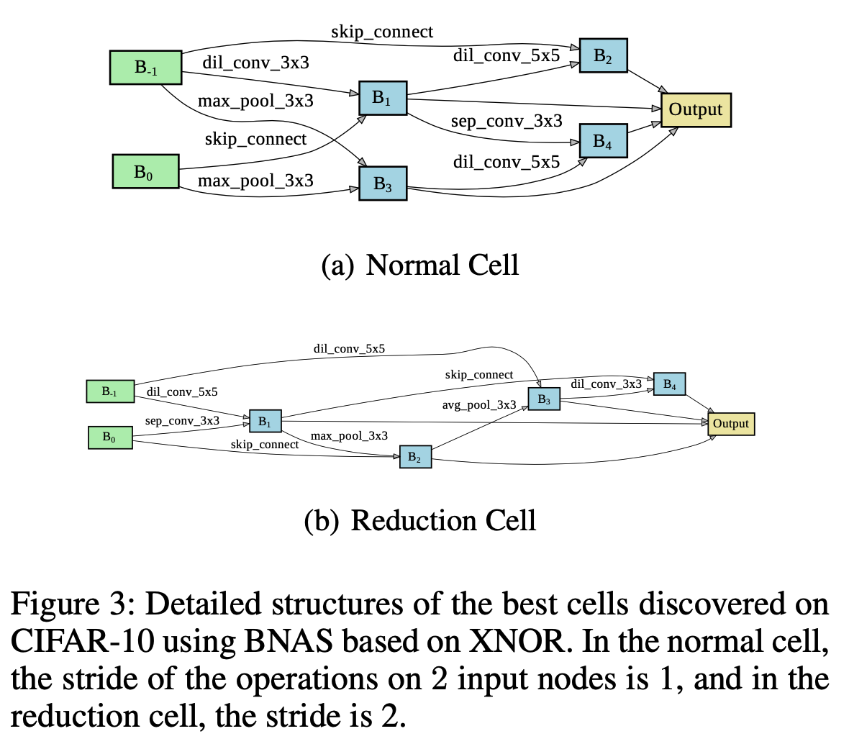
Experiment – Results on CIFAR-10

Slide 15
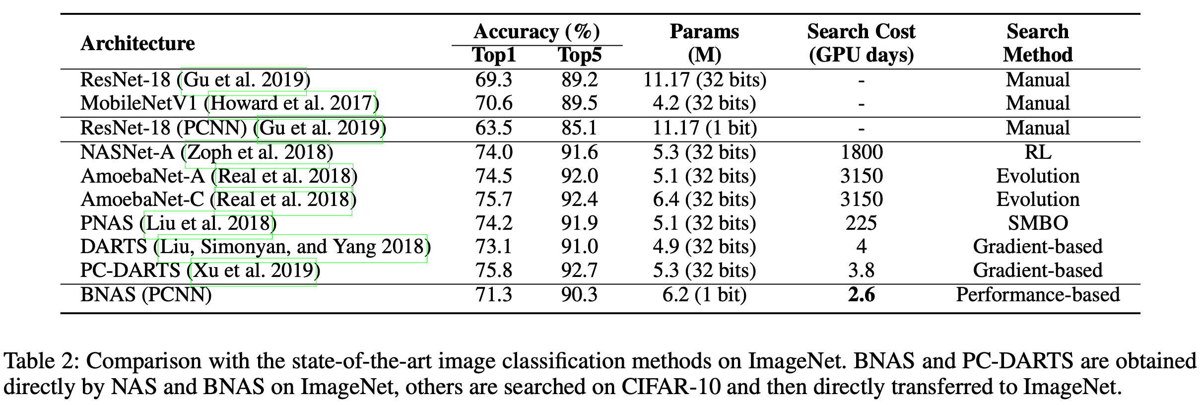
Experiment -- Results on Imagenet
BNAS (PCNN) performs better than human-designed binarized networks (71.3% vs. 63.5%) and has far fewer parameters (6.1M vs. 11.17M) ;
BNAS (PCNN) has a performance similar to the human-designed full-precision networks (71.3% vs. 70.6%), with a much more highly compressed model;
Compared with the full-precision networks obtained by other NAS methods, BNAS (PCNN) has little performance drop, but is fastest in terms of search efficiency (0.09375 vs. 0.15 GPU days) and is a much more highly compressed model due to the binarization of the network.
Notes:
1.和人工设计的BNN网络相比，准确率更高，模型更小
2.和人工设计的float32网络相比，准确率都略高
3.

